Slide 1
OPTICAL COMMUNICATION
Module 1
Optical Fiber and their properties

Slide 2
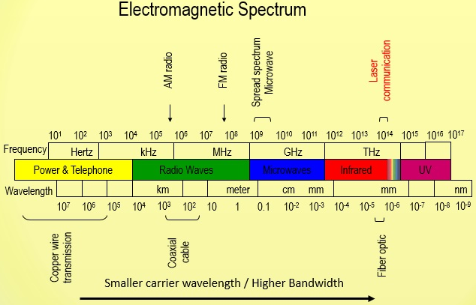

Slide 3
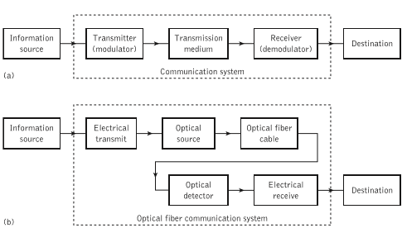
General communication system &Optical fiber communication system

Slide 4
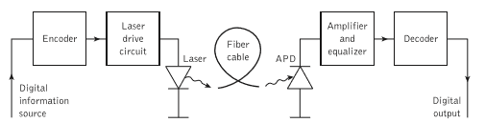
A digital optical fiber link using a semiconductor laser source and an avalanche photodiode (APD) detector

Slide 5
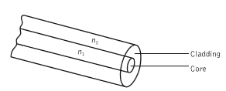
Optical fiber as waveguide

Slide 6
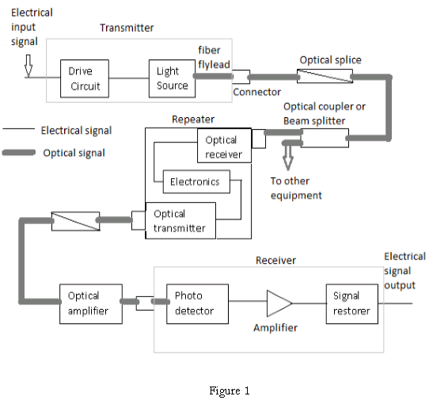

Slide 7
The optical fiber consists of three main elements:
Transmitter: An electric signal is applied to the optical transmitter. The optical transmitter consists of driver circuit, light source and fiber flylead.
Driver circuit drives the light source.
Light source converts electrical signal to optical signal.
Fiber flylead is used to connect optical signal to optical fiber.
Transmission channel: It consists of
a cable that provides mechanical and environmental protection to the optical fibers contained inside. Each optical fiber acts as an individual channel.
Optical splice is used to permanently join two individual optical fibers.
.

Slide 8
Optical connector is for temporary non-fixed joints between two individual optical fibers.
Optical coupler or splitter provides signal to other devices.
Repeater converts the optical signal into electrical signal using optical receiver and passes it to electronic circuit where it is reshaped and amplified as it gets attenuated and distorted with increasing distance because of scattering, absorption and dispersion in waveguides, and this signal is then again converted into optical signal by the optical transmitter

Slide 9
Receiver: Optical signal is applied to the optical receiver. It consists of photo detector, amplifier and signal restorer.
Photo detector converts the optical signal to electrical signal.
Signal restorers and amplifiers are used to improve signal to noise ratio of the signal as there are chances of noise to be introduced in the signal due to the use of photo detectors.

Slide 10
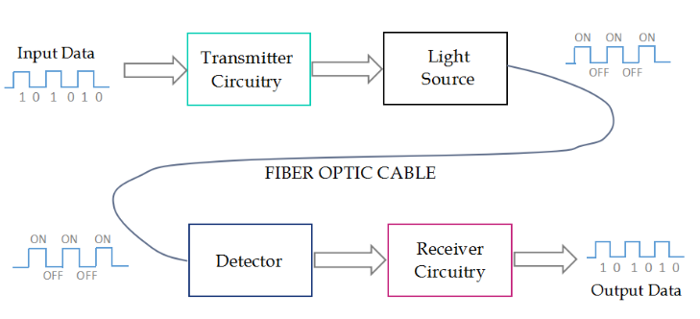
Block Diagram

Slide 11
Ray theory
Total Internal Reflection
-It is a phenomenon occurs at interface between 2 dielectrics of differing refractive indices when light is incident on the dielectric of lower refractive index from that of higher refractive index and angle of incidence exceeds the value of critical angle.

Slide 12
Fiber structure

Slide 13
Light propagation inside Fiber
Meridional Ray
Passes through axis of the fiber.
Follows a Zig Zag path.

Slide 14
ACCEPTANCE ANGLE
For rays to be transmitted by total internal reflection, they should incident on fiber core within an acceptance cone defined by conical half angle.
Maximum angle to the axis at which light may enter the fiber in order to be propagated is known as acceptance angle.

Slide 15
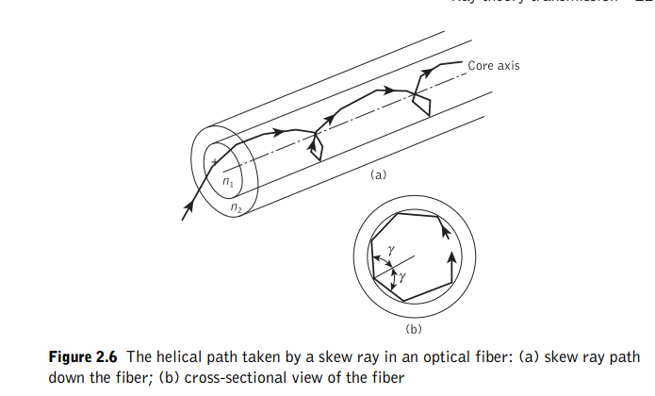

SKEW RAYS

Slide 16
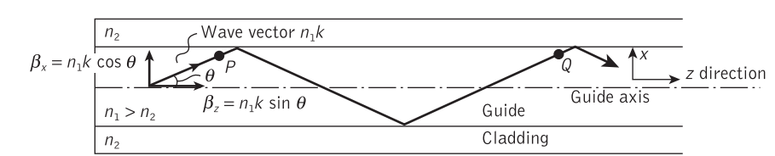
Modes in a planar waveguide
The stable field distribution in the x direction with only a periodic z dependence is known as a mode.
A specific mode is obtained only when the angle between the propagation vectors or the rays and the interface have a particular value

Slide 17
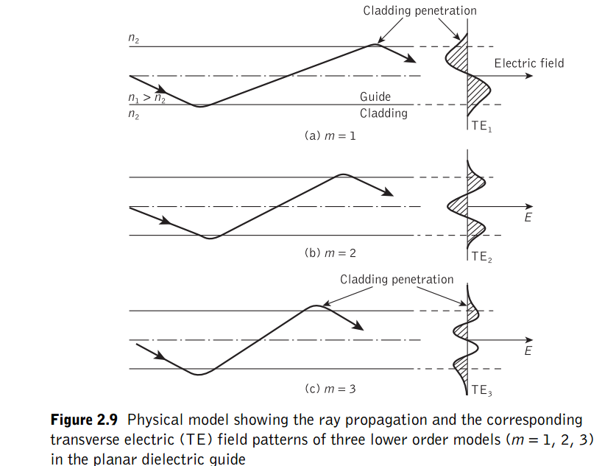

Slide 18
m denotes the number of zeros in this transverse field pattern.
In this way m signifies the order of the mode and is known as the mode number.
when the electric field is perpendicular to the direction of propagation and hence Ez=0, but a corresponding component of the magnetic field His in the direction of propagation. In this instance the modes are said to be transverse electric (TE).
Alternatively, when a component of the E field is in the direction of propagation, but Hz =0, the modes formed are called transverse magnetic
(TM).
The mode numbers are incorporated into this nomenclature by referring to the TEm and TMm modes

Slide 19
When the total field lies in the transverse plane, transverse electromagnetic (TEM) waves exist where both Ez and Hz are zero.
However, although TEM waves occur in metallic conductors (e.g. coaxial cables) they are seldom found in optical waveguides

Slide 20
Modes in cylindrical fibers
In common with the planar guide TE (where Ez=0) and TM (where Hz =0) modes are obtained within the dielectric cylinder.
The cylindrical waveguideis bounded in two dimensions rather than one. Thus two integers, l and m, are necessary in order to specify the modes, in contrast to the single integer (m) required for the planar guide.
For the cylindrical waveguide we therefore refer to TElm and TMlm modes. These modes correspond to meridional rays traveling within the fiber.
However, hybrid modes where Ez and Hz are nonzero also occur within
the cylindrical waveguide

Slide 21
These modes, which result from skew ray propagation within the fiber, are designated HElm and EHlm depending upon whether the components of H or E make the larger contribution to the transverse field.
Thus an exact description of the modal fields in a step index fiber proves somewhat
complicated.
The analysis may be simplified when considering optical fibers for communication purposes. These fibers satisfy the weakly guiding approximation where the relative index difference Δ << 1.
Δis usually less than 0.03 (3%) for optical communications fibers.
For weakly guiding structures with dominant forward propagation, mode theory gives dominant transverse field components.
Hence approximate solutions for the full set of HE, EH, TE and TM modes may be given by two linearly polarized components

Slide 22
These linearly polarized (LP) modes are not exact modes of the fiber except for the fundamental (lowest order) mode.
However, as Δ in weakly guiding fibers is very small, then HE–EH mode pairs occur which have almost identical propagation constants. Such modes are said
to be degenerate.
The superpositions of these degenerating modes characterized by a common propagation constant correspond to particular LP modes regardless of their HE, EH,
TE or TM field configurations.
This linear combination of degenerate modes obtained from the exact solution produces a useful simplification in the analysis of weakly guiding fibers.

Slide 23
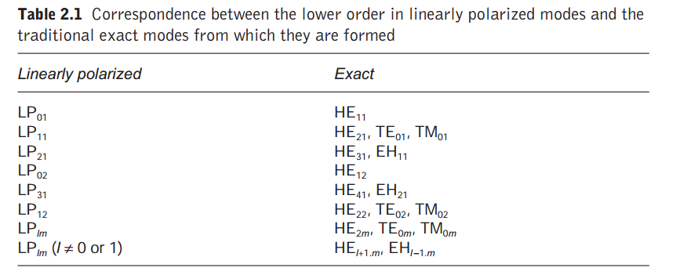

Slide 24
